Slide 1
MASTpla
Smeets, T., et al. (2012). Introducing the Maastricht Acute Stress Test (MAST) - A quick and undemanding approach to elicit solid cardiovascular and glucocorticoid stress responses. Psychoneuroendocrinology, 37, 1998-2008.

Slide 2
About this task:
In the following task you will be asked to immerse your hand – including the wrist joint – in lukewarm water. You are not allowed to make a fist or place your hand on the bottom of the box.
You will be asked to do this several times, and in between these “trials”, you will have to perform a simple counting task. There also will be 1 rest period.
The total duration of this task is about 12 minutes.
If you’ve finished reading the instructions above and do not have questions, press the Space button.

Slide 3
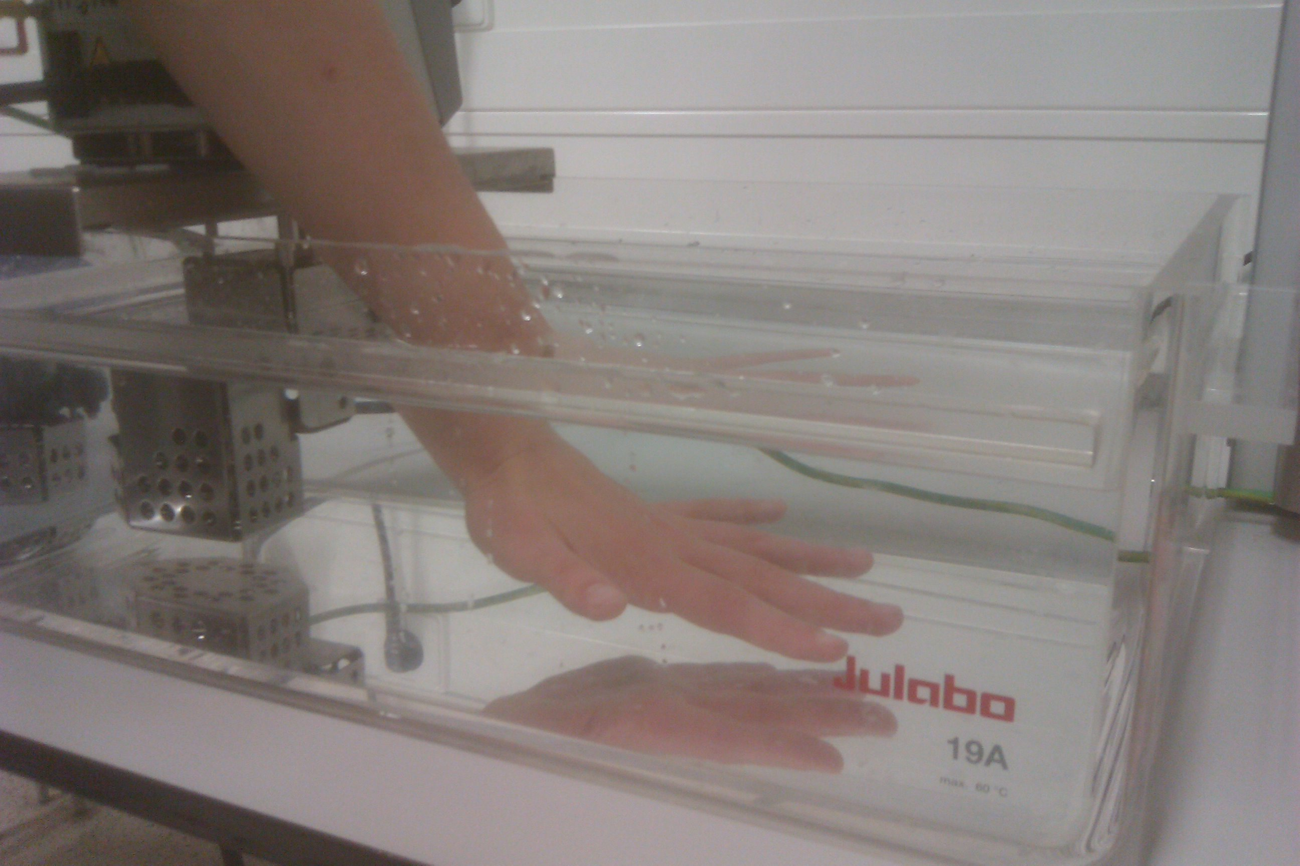
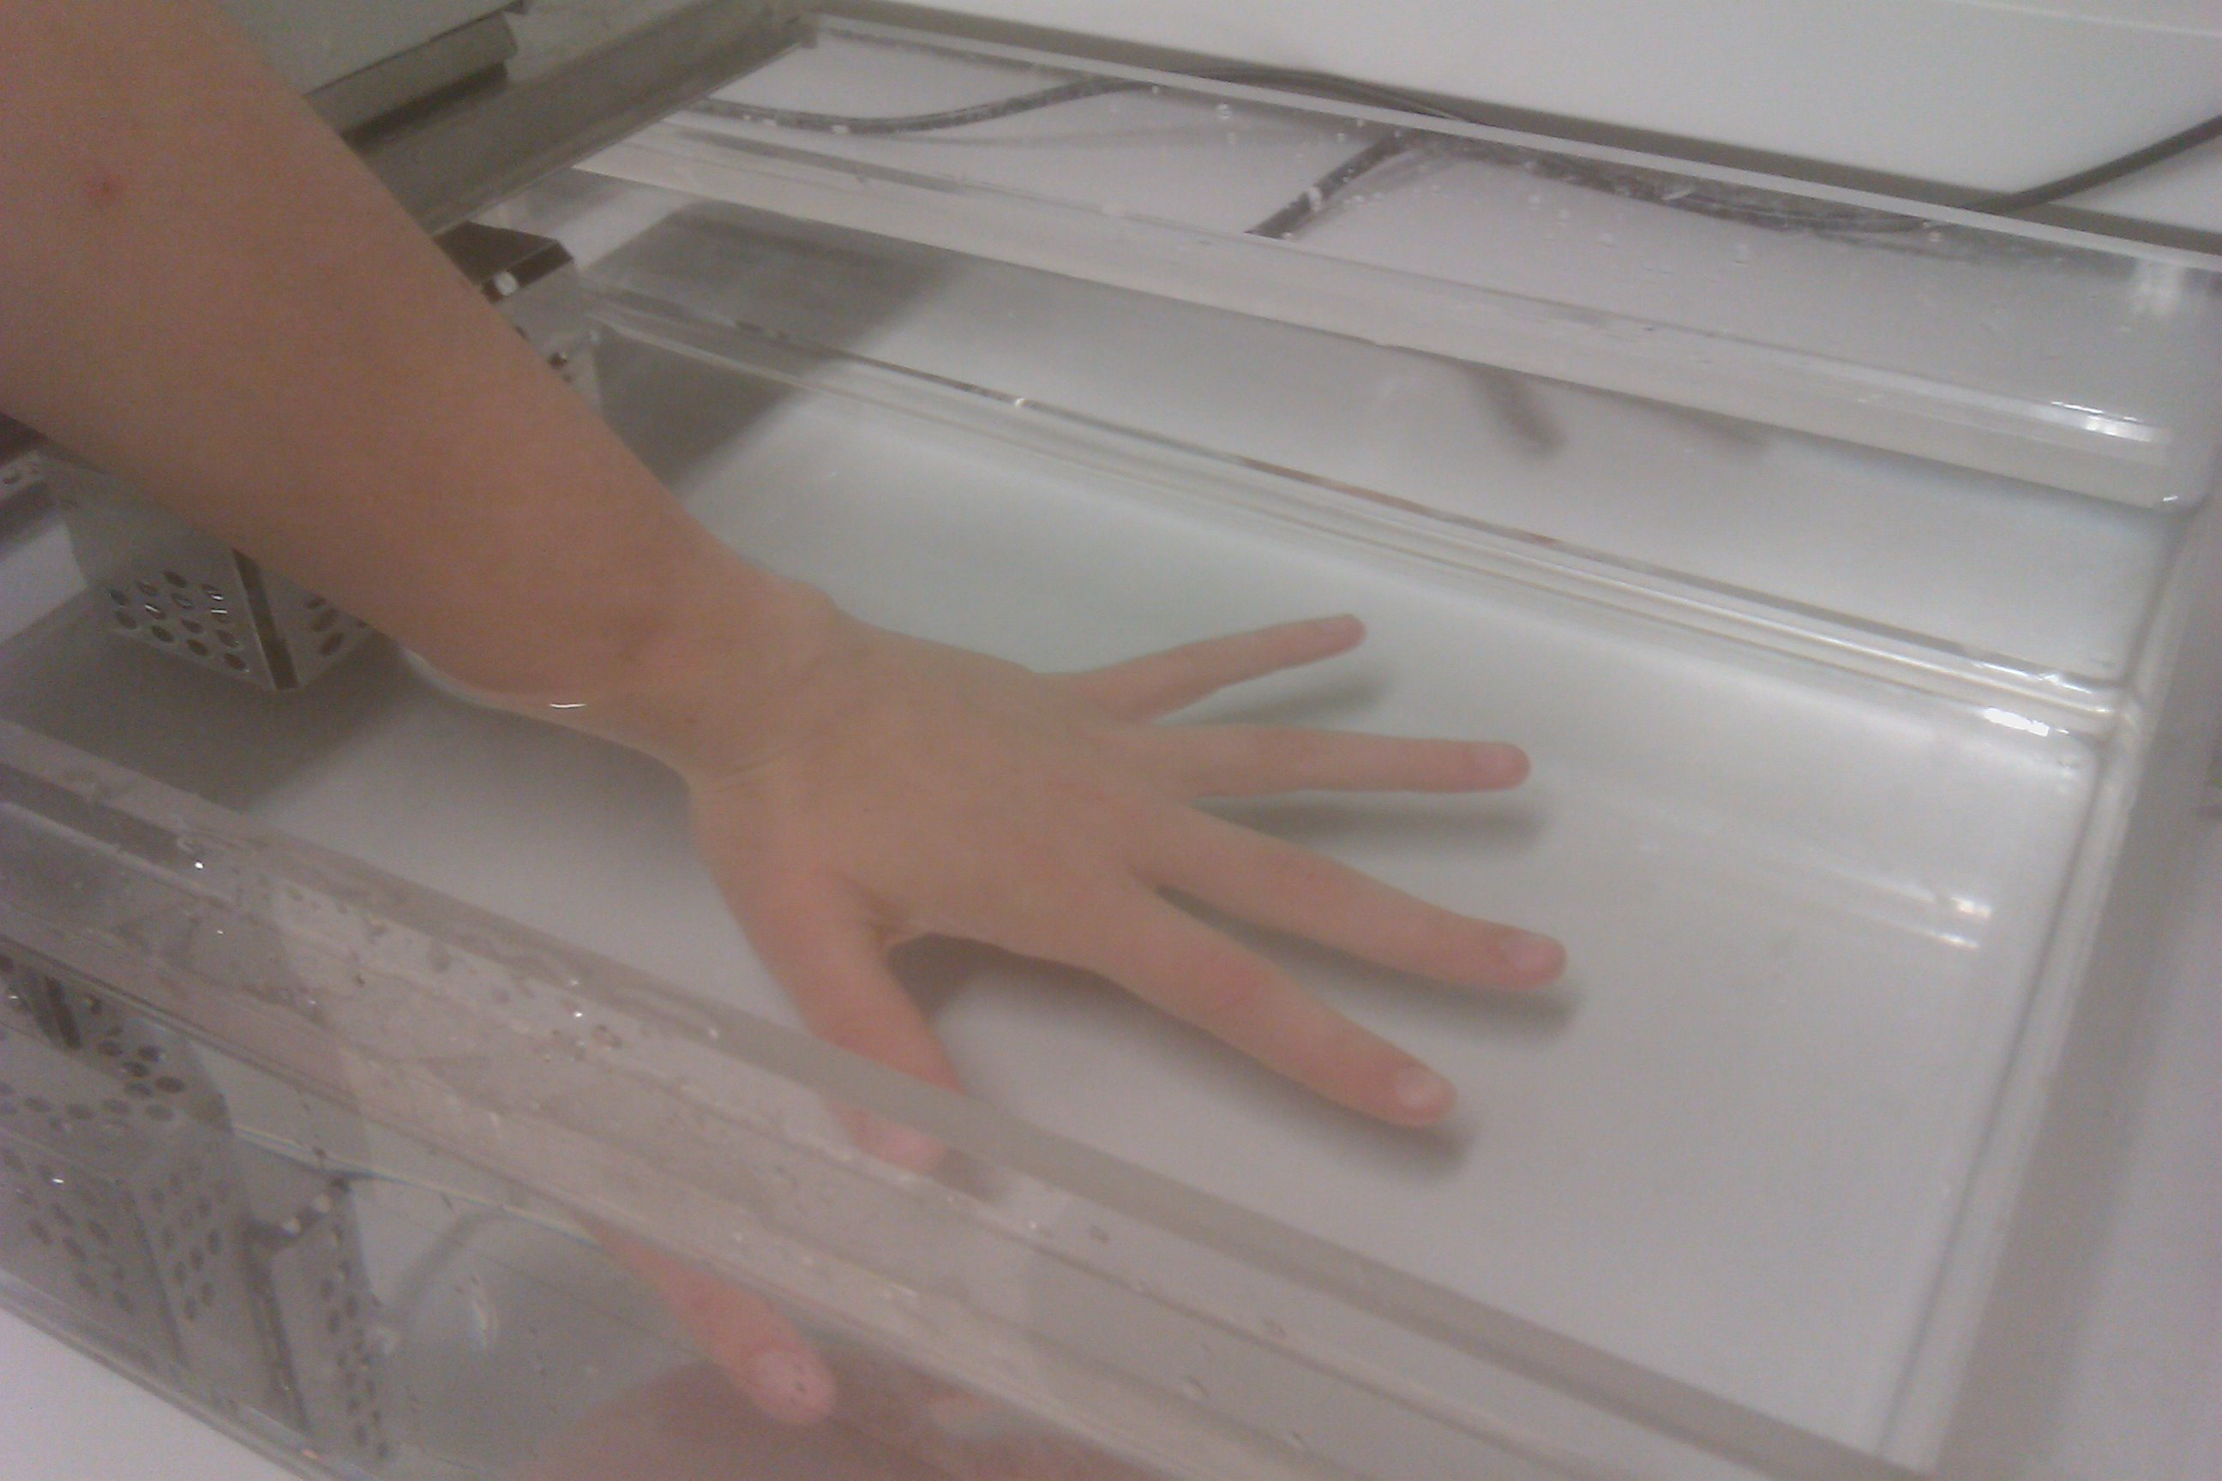
When you are asked to immerse your hand in the water, do it like this:
If you’ve finished reading the instructions above and do not have questions, press the Space button.

Slide 4
Instructions:
During trials in which you have to immerse your hand in the water, you will see the instruction “ARM IN WATER” on the screen.
You have to hold your hand in the water until you are instructed to remove it. In that case, you will read “RETRACT ARM” on the screen.
If you’ve finished reading the instructions above and do not have questions, press the Space button.

Slide 5
Important!
The computer will randomly decide how long you have to immerse your hand in the water, but the “trials” will never be longer than 90 seconds.
The duration of periods in between the trials will also be randomly chosen. However, these periods last for minimally 45 seconds.
If you’ve finished reading the instructions above and do not have questions, press the Space button.

Slide 6
Important (2)!
During the periods in which you do not have to hold your hand in the water, you will be asked to simply count from 1 to 25 or the number correctly mentioned last by you, and you can choose the speed at which you count.
  Example: 1 – 2 – 3 – 4 – 5 – 6 – …
Whenever you arrive at 25, please just start over at 1.
Please start counting immediately after you see this instruction on the screen:
Count from 1 to 25.
If you’ve finished reading the instructions above and do not have questions, press the Space button.

Slide 7
Important(3)!
There will also be a rest period.
In this period you will be asked to provide a saliva sample and, if applicable, to complete a short questionnaire.
If you’ve finished reading the instructions above and do not have questions, press the Space button.

Slide 8
Also important!!
This task merely serves as a control condition for another task and may seem boring and/or useless.
However, this task is essential for this study, and we kindly ask you to perform it to the best of your abilities.
Thank you very much for your cooperation.
If you’ve finished reading the instructions above and do not have questions, press the Space button.

Slide 9
Even more important!!!
As in any other study, you have the right to withdraw from the task and end your participation in this study at any time.
  This right is granted to you by law and must be guaranteed to participants according to the local ethical committee of the Faculty of Psychology and Neuroscience, Maastricht University
  (ECP, see protocol number ECP77-3-01-2009-2).
If you’ve finished reading the instructions above and do not have questions, press the Space button.

Slide 10
Please now focus on the task at hand; the task will start as soon as the experimenter presses the Space button.
Good luck!

Slide 12

ARM IN WATER

Slide 13
RETRACT ARM
Count from 1 to 25.

Slide 14
ARM IN WATER

Slide 15
RETRACT ARM
Count from … to 25.

Slide 16
ARM IN WATER

Slide 17
RETRACT ARM
Count from … to 25.

Slide 18
ARM IN WATER

Slide 19
RETRACT ARM
Count from … to 25.

Slide 20
ARM IN WATER

Slide 21
RETRACT ARM
REST PERIOD

Slide 22
Congratulations!
This is the end of the task

